Slide 1

GeneX
Genetics made practical

Slide 2







Typical guides fall short
There are many parenting books and guidelines on the market.
Notes:
Plot: the books fall over each other (stack of books), and make a stack of books.
Voice over: There There are many parenting books and guidelines on the market

Slide 3
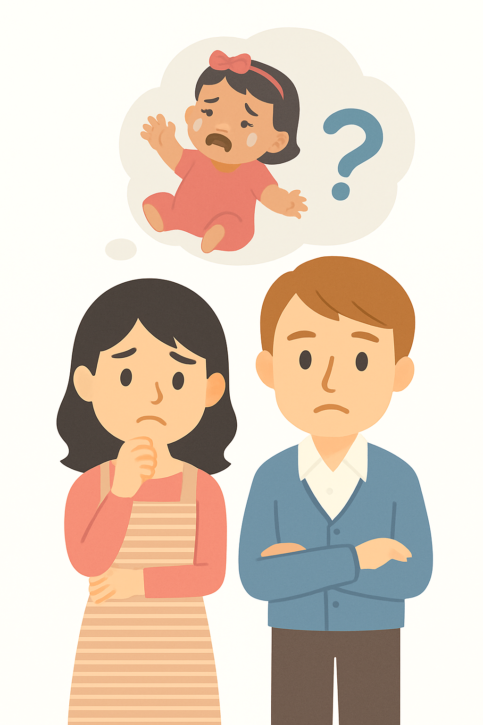





Typical guides fall short
But typical parenting guides don’t fit every child.
Birth
2m
4m
6m
8m
10m
Notes:
Plot: milestone bar appears, and those milestones get added one by one
Voice Over: But typical parenting guidelines don’t fit every child, especially when genetic condition is in the picture.

Slide 4
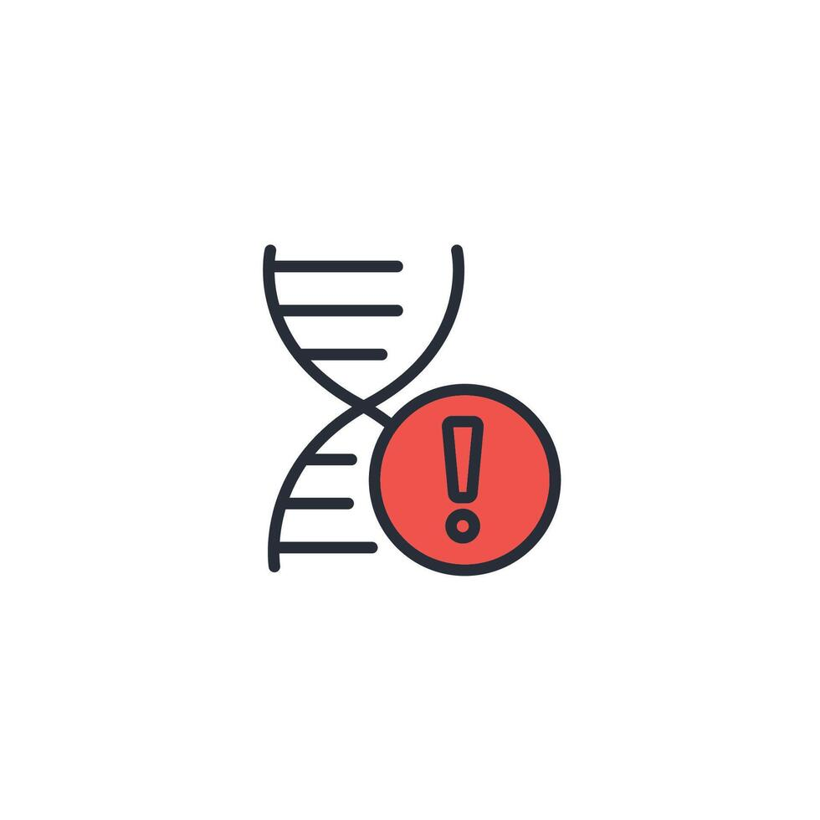

Typical guides fall short
Especially when a genetic condition is in the picture.
Notes:
Plot: The books are stack over each other, the icon of genetic condition comes and immediately a red cross follows it over the stack of the books over the previous picture you had in slide #2 (meaning those books are useless now)
Voice Over: especially when genetic condition is in the picture.

Slide 5
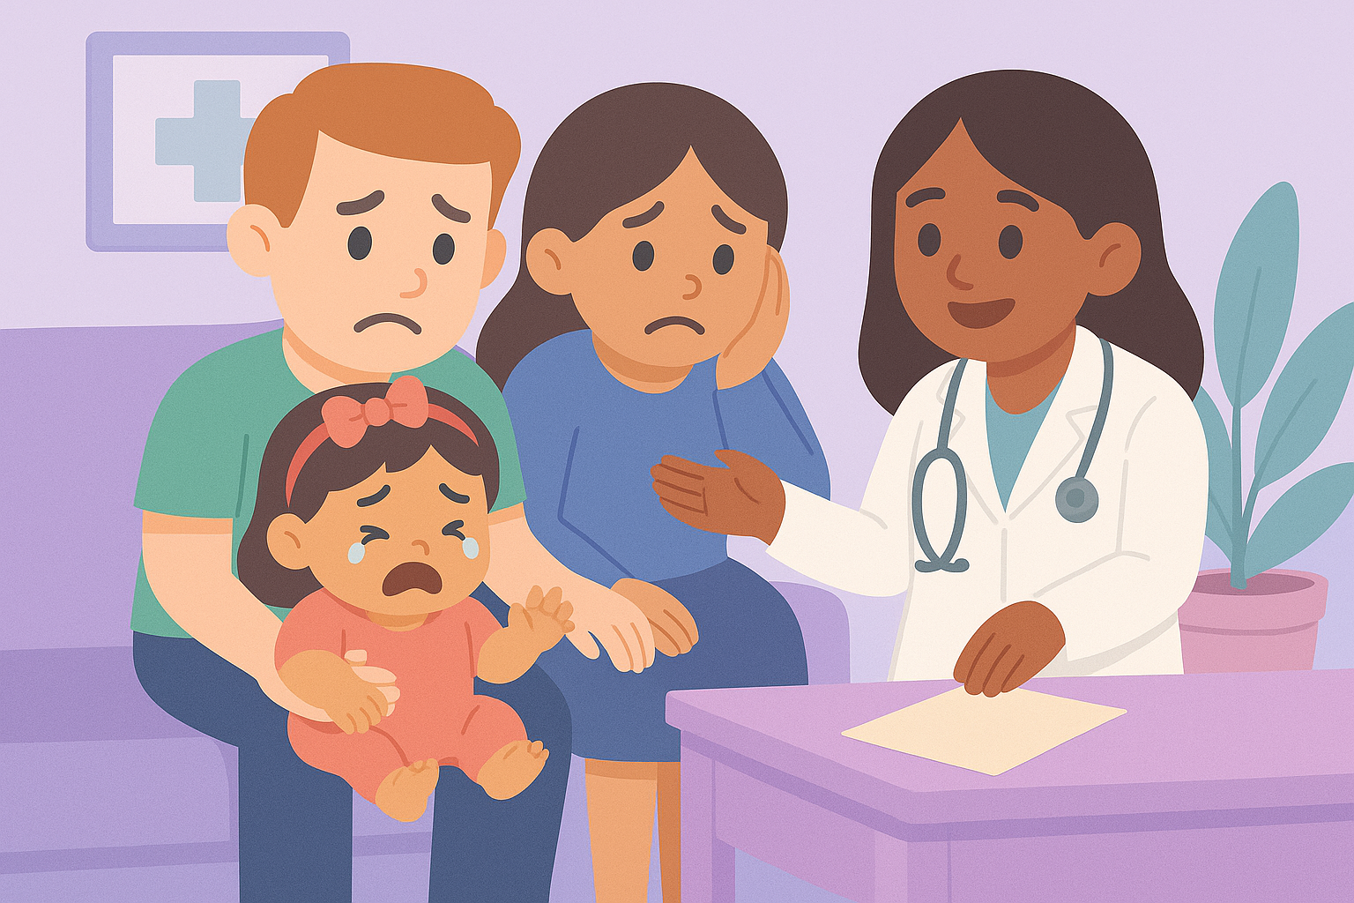
Diagnosis… then what?
Notes:
Voice Over: Millions of families are navigating genetic or developmental conditions. Parents leave hospitals with a diagnosis—but no Tuesday plan.

Slide 6
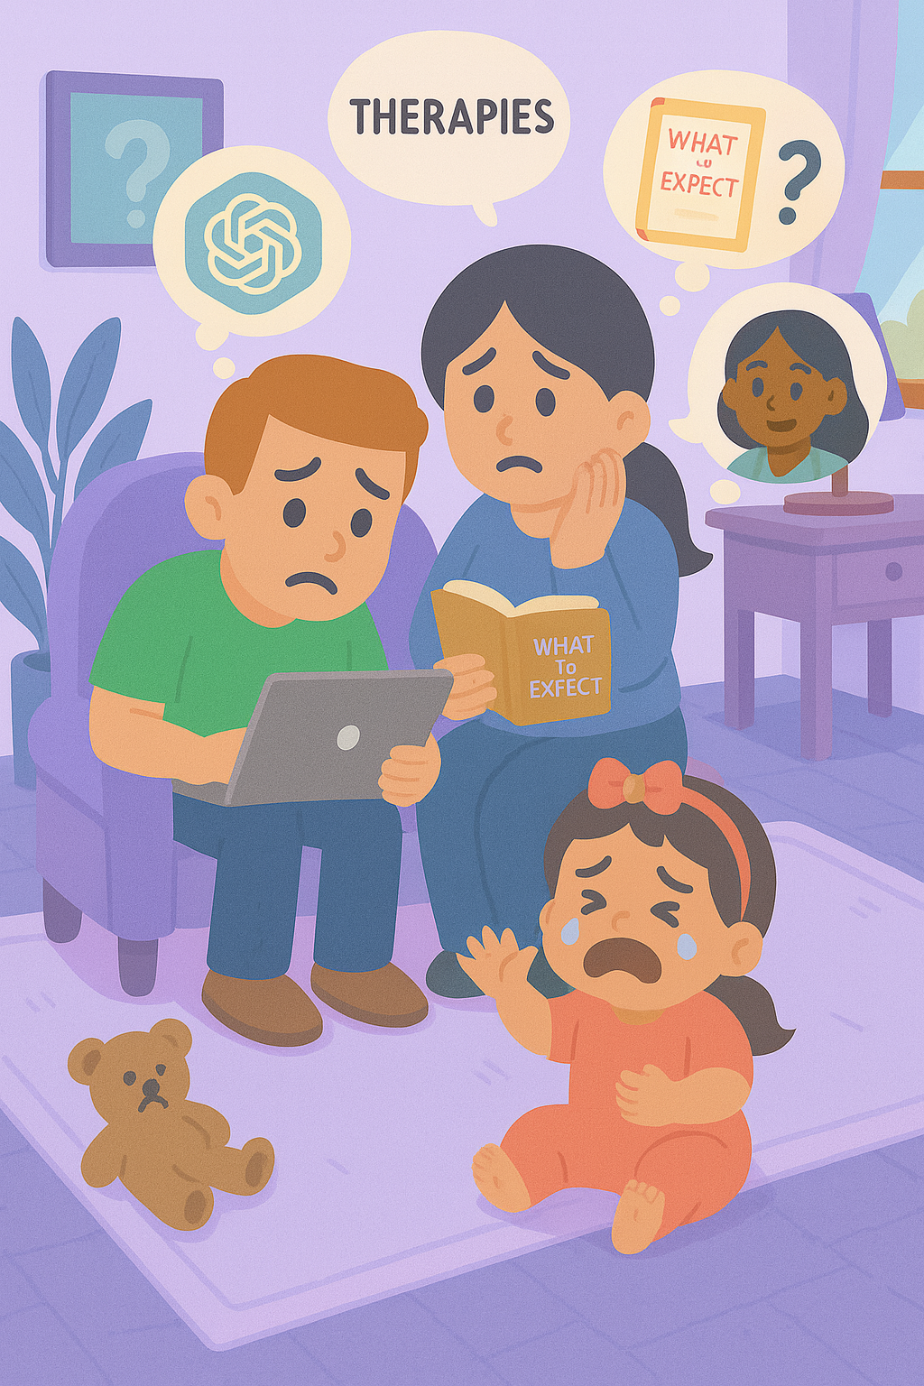
Diagnosis… then what?
Guidance is fragmented
Routines are hard to follow
and support often feels out of reach.
Notes:
Plot: The photo of family appears, then while the voice going over these three points, the icon and text for each one appears one by one.
Voice over: The guidance is fragmented, routines are hard to follow, and support often feels out of reach.

Slide 7

That’s why we built Genex

Slide 8




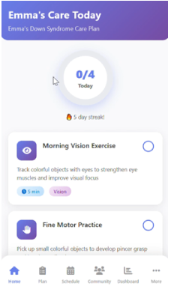

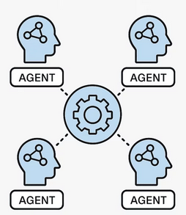





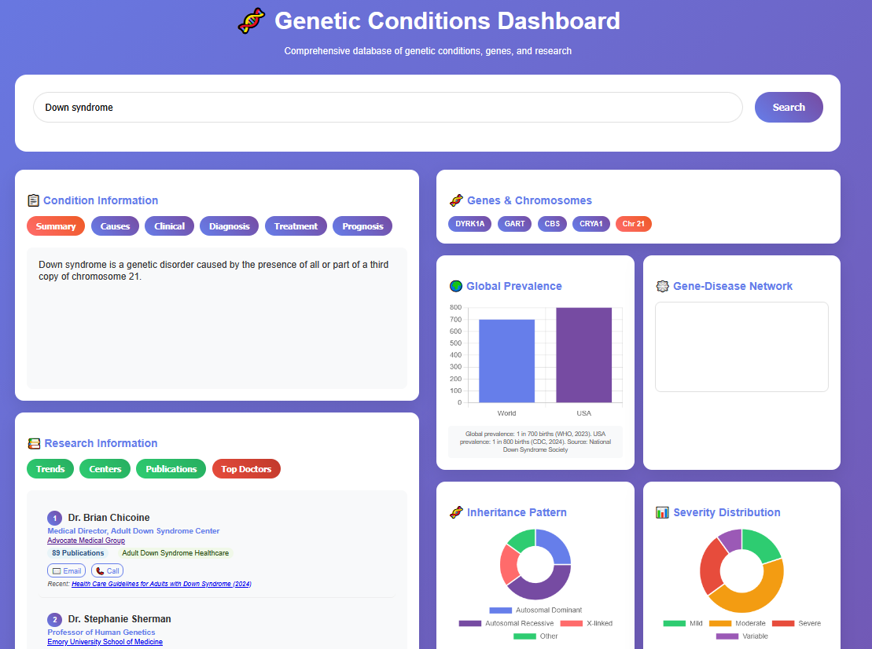

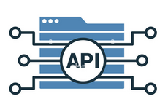


Genex – Technology
An AI care framework that learns with every family
Genex Core AI
Knowledge Graphs
Notes:
Plot: icons progress from left to write, all the data sources feed to the core AI model and core AI model creates the app and dashboard. And there would be a loop to feedback from app and dashboard to the core AI.
Voice over:
At Genex, we’re creating an intelligent care framework that learns with every family.
Our platform brings together various data — such research papers, clinical guidelines, and even family feedback.
Through a workflow engine, AI agents interpret complex genomic and clinical data — converting it into clear, actionable routines for everyday life . At its core lies a biomedical knowledge graph — transforming fragmented data into insight. Our fine-tuned language models generate personalized care plans. Genex runs on micro-agents data lake architecture.
Privacy is woven into every layer and new evidence and every interaction — from clinician feedback to family input — feeds back into our knowledge graph. With each loop, Genex grows smarter.
Our technology creates genex app as well as our dashboard.

Slide 9
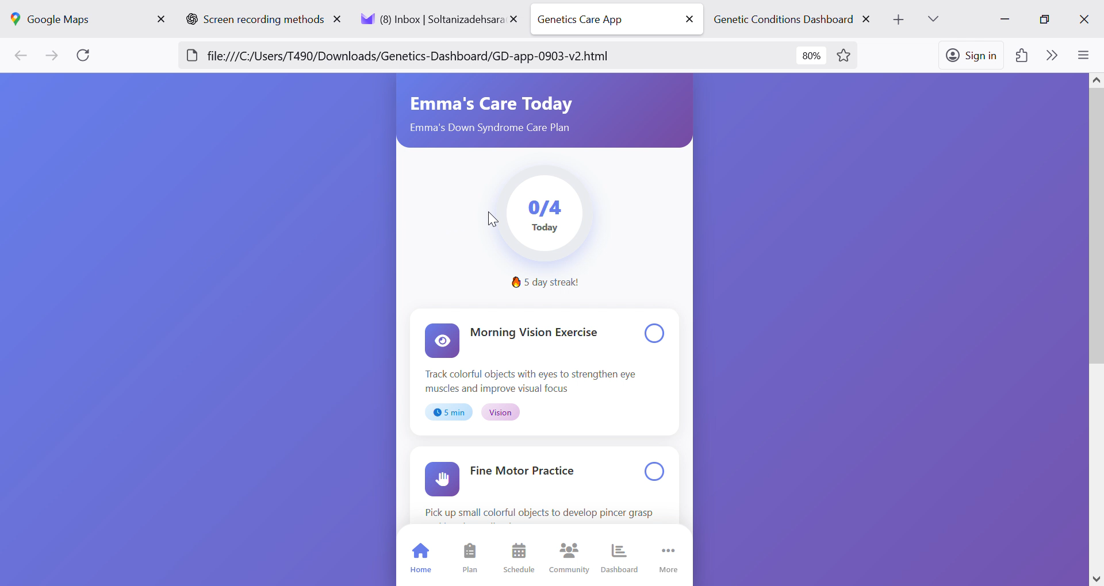
Genex – App
With:
Care plans
Curated daily 5–10 minutes activities
gentle reminders
progress tracking
community support
Notes:
Plot: The video plays and voice go over the voice over at the same time. The family doing daily activities drop one by one at the same time
Voice over: With curated, 5–10 minutes exercises, gentle reminders, progress tracking, community support, families gain confidence, schools stay aligned,
and children get consistent help - every day.

Slide 10
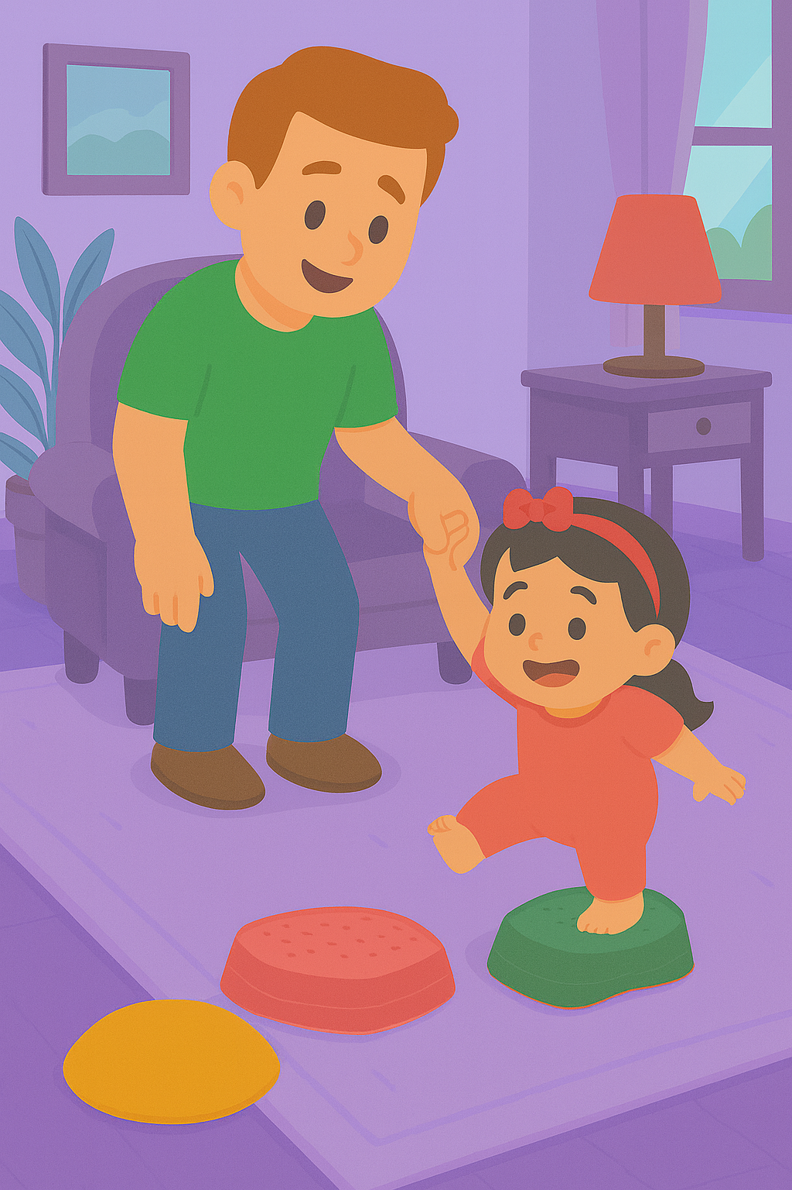
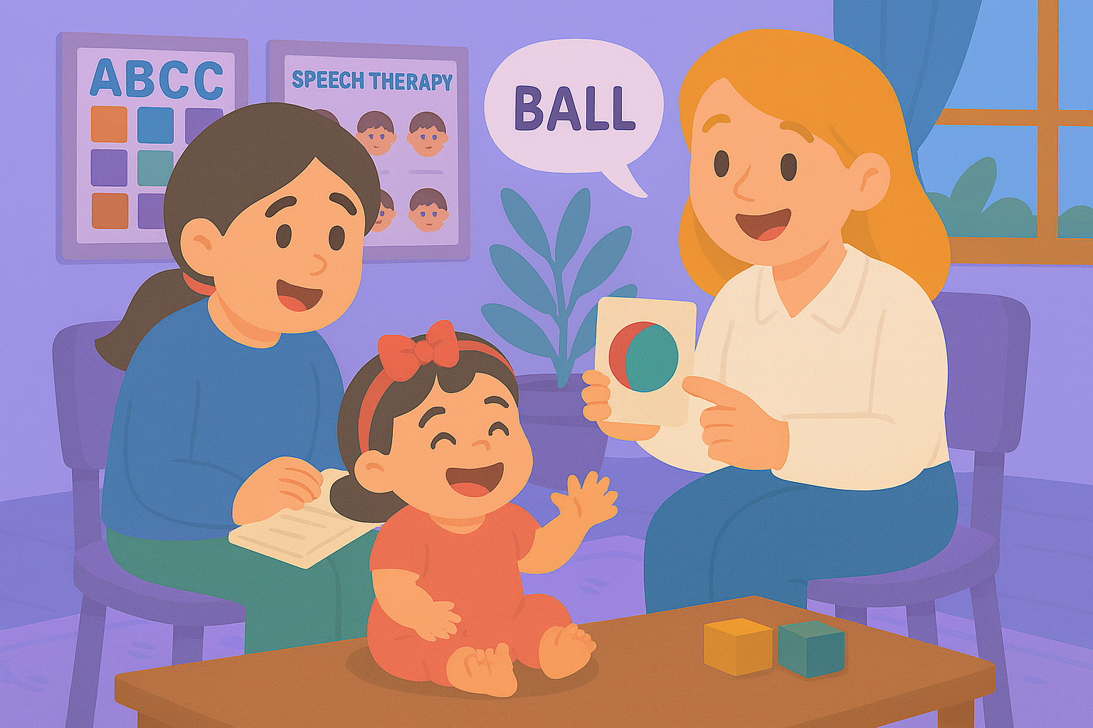
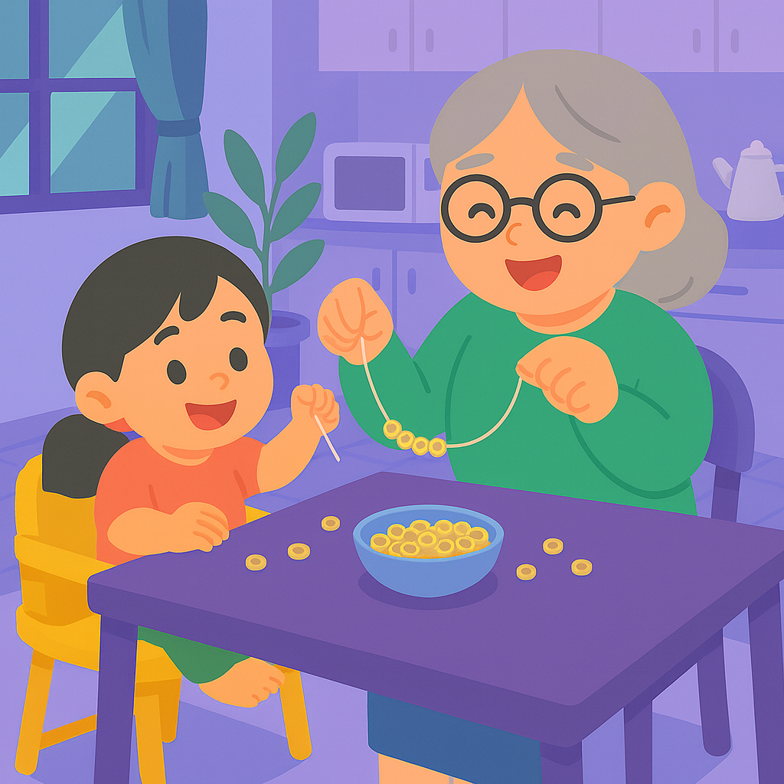
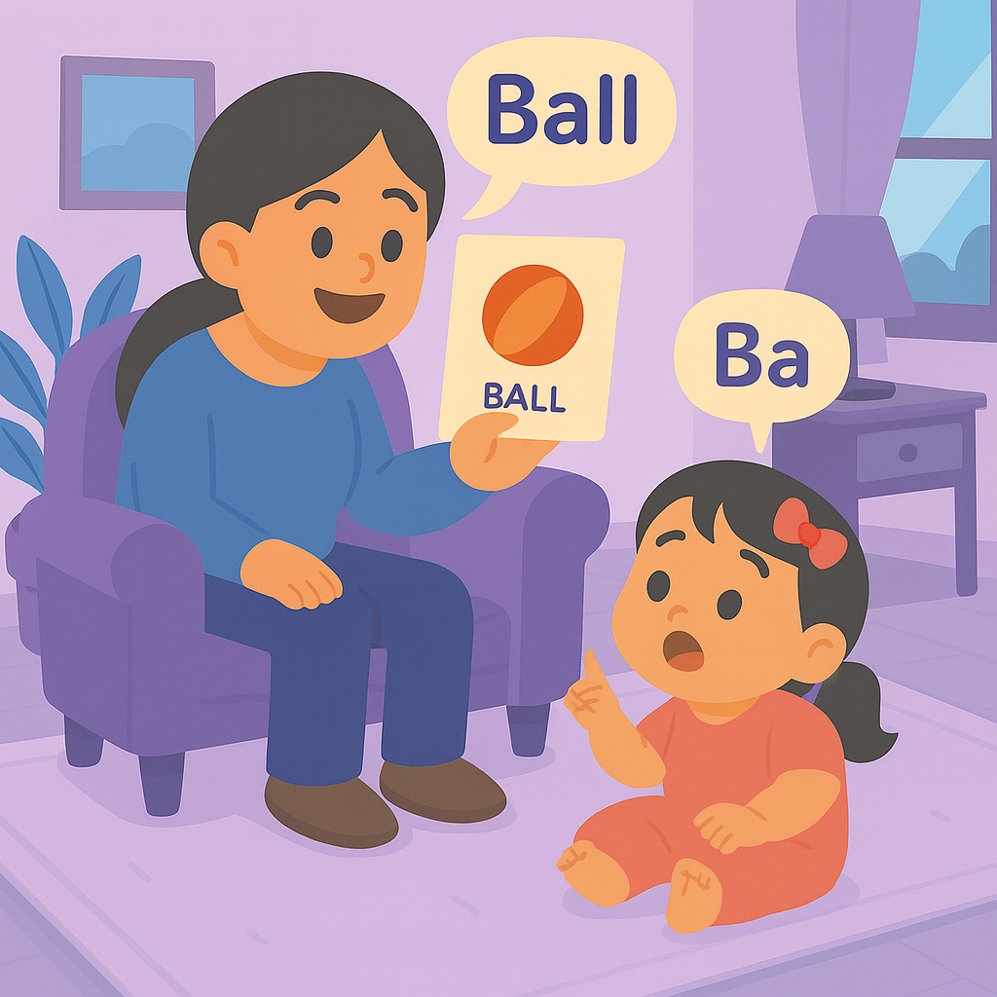
Genex – App
Helps:
families gain confidence
schools stay aligned
and children get consistent help - every day.
Notes:
Plot: The video plays and voice go over the voice over at the same time. The family doing daily activities drop one by one at the same time
Voice over: With curated, 5–10 minutes exercises, gentle reminders, progress tracking, community support, families gain confidence, schools stay aligned,
and children get consistent help - every day.

Slide 11
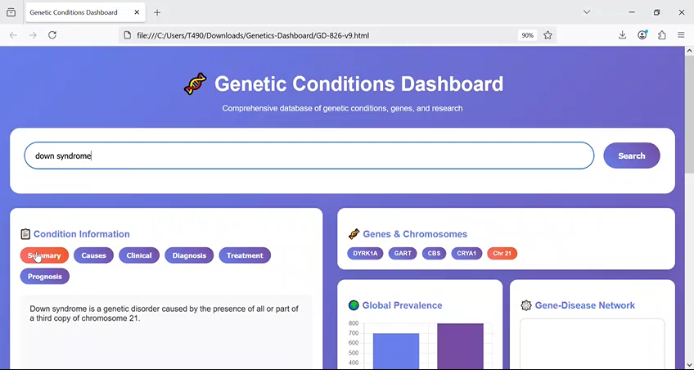
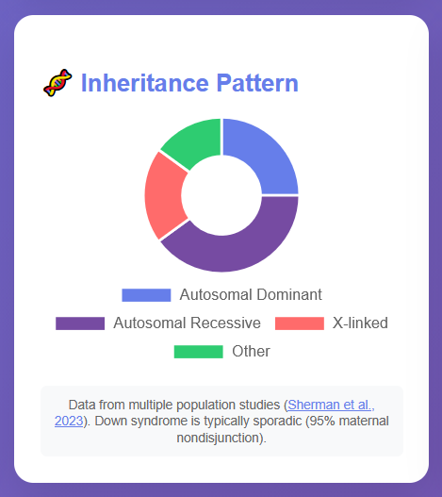
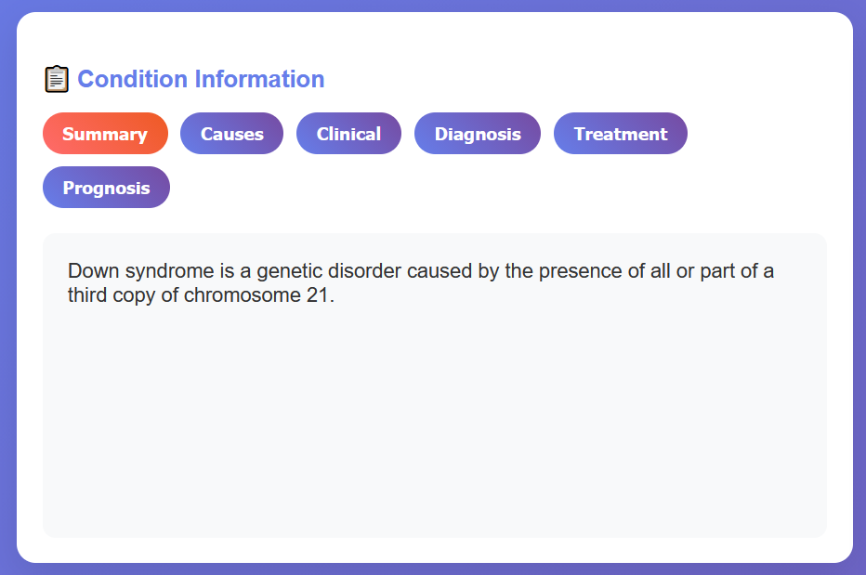
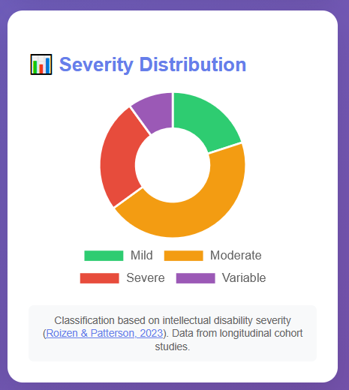
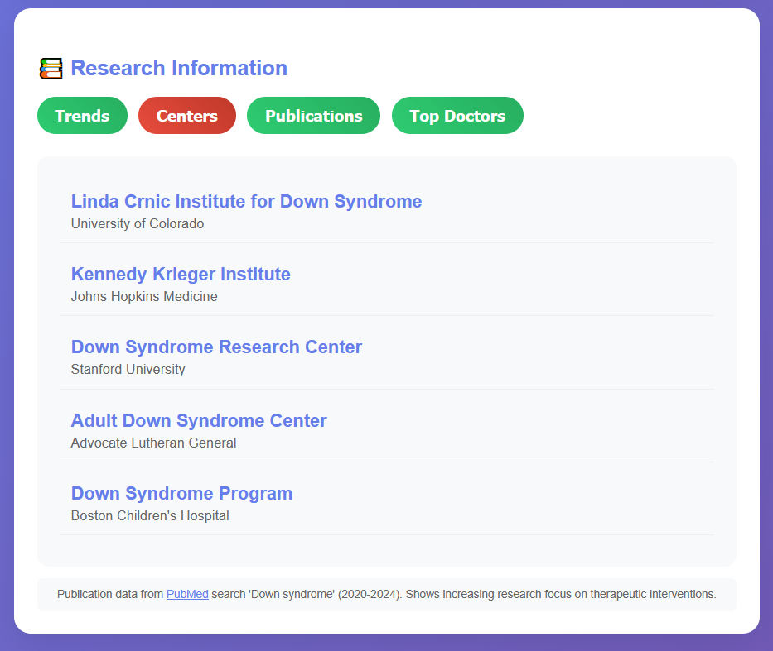
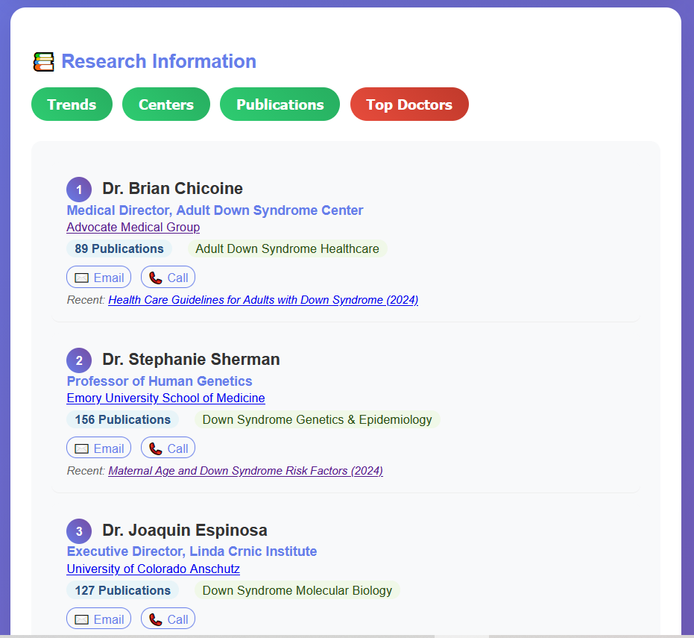
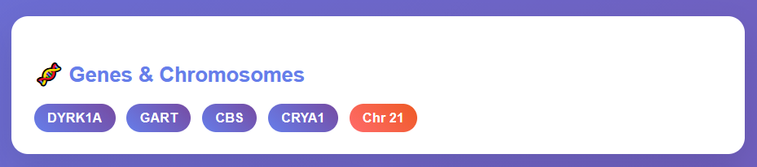
Genex – Dashboard
Offers:
Search and condition cards with source and confidence
At a glance visuals
Research lens including centers and top clinicians
Notes:
Plot: The video plays and voice go over the voice over at the same time. Need to zoom in every part of the dashboard when we are talking about it in the voice over
Voice over: Genex dashboard offers search and condition cards with source and confidence, at a glance visuals, and research lens including centers and top clinicians.

Slide 12
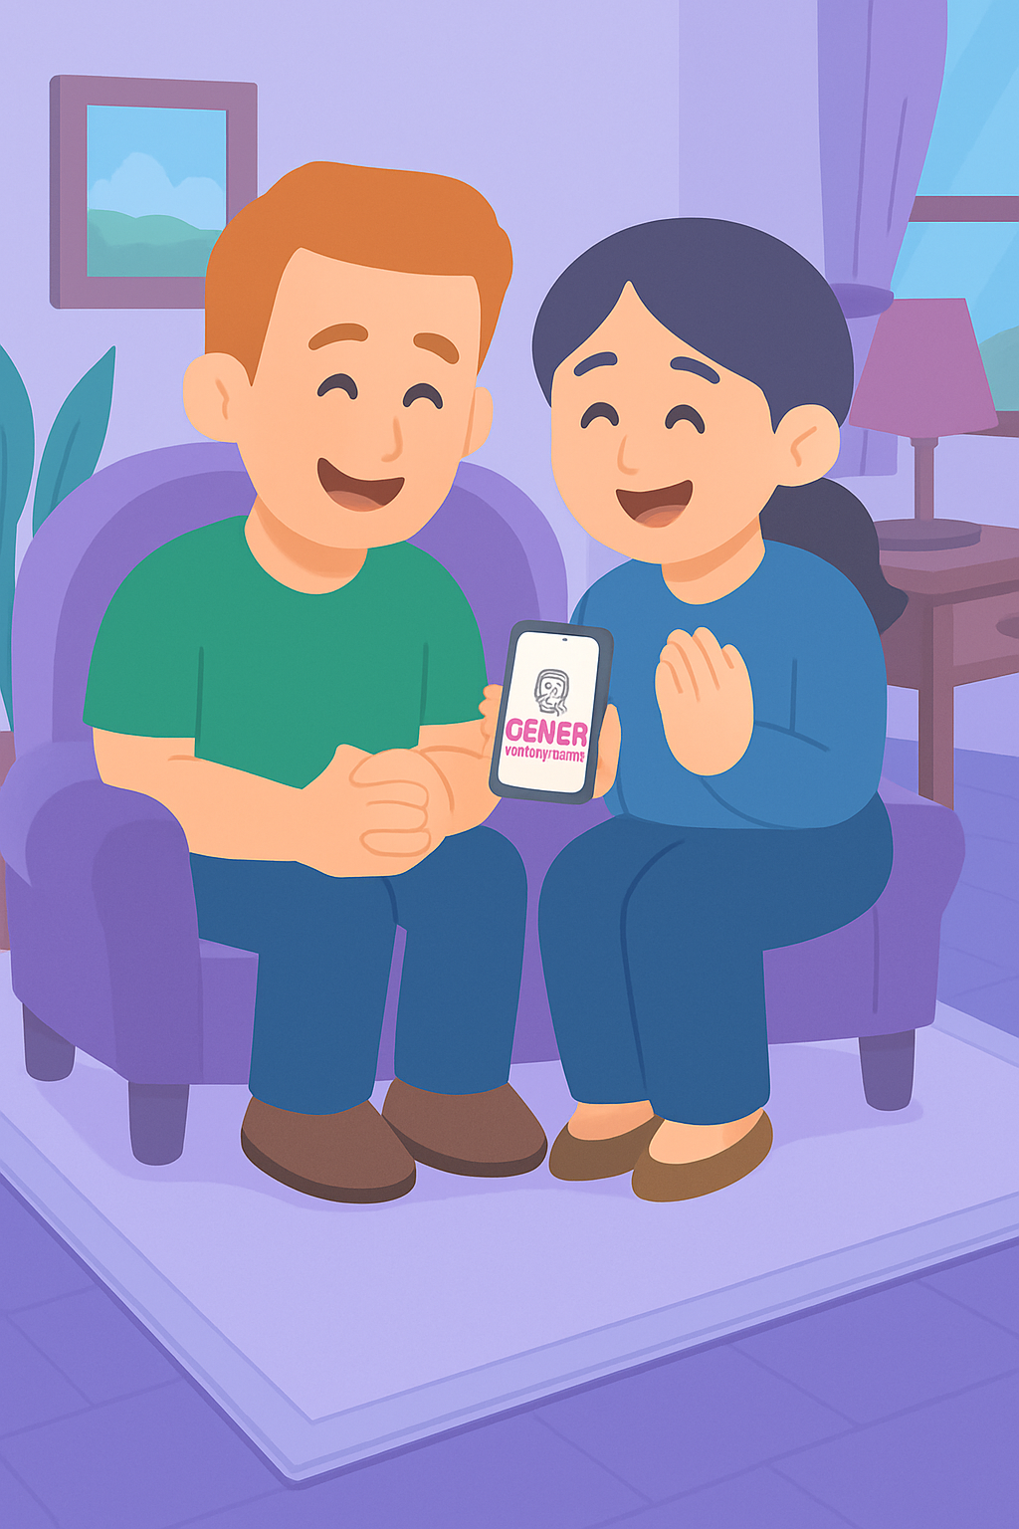
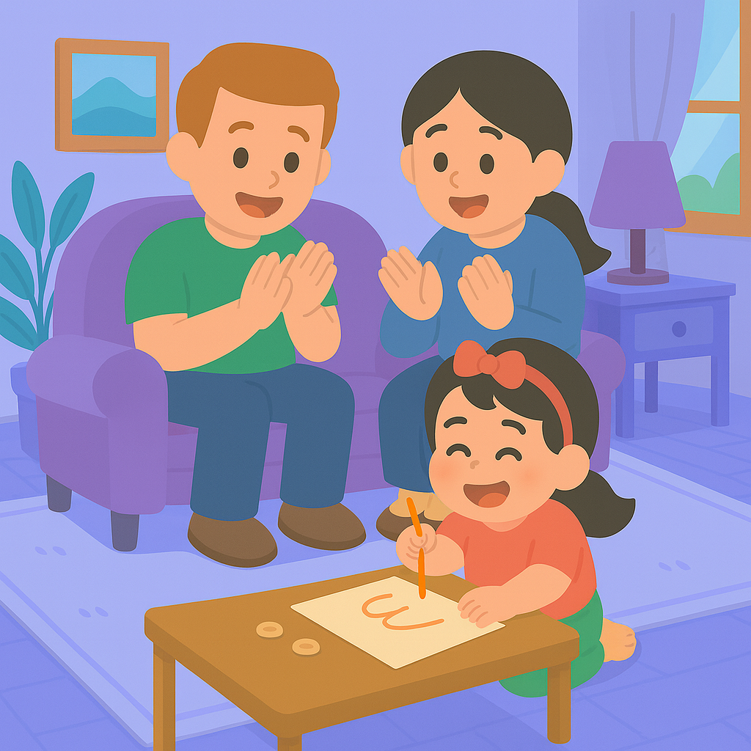
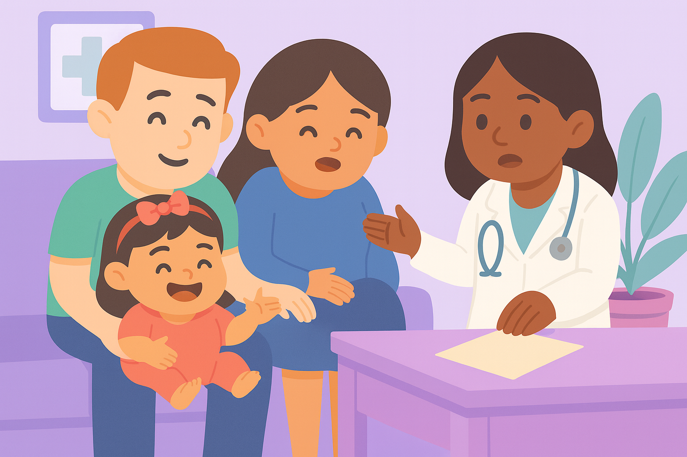
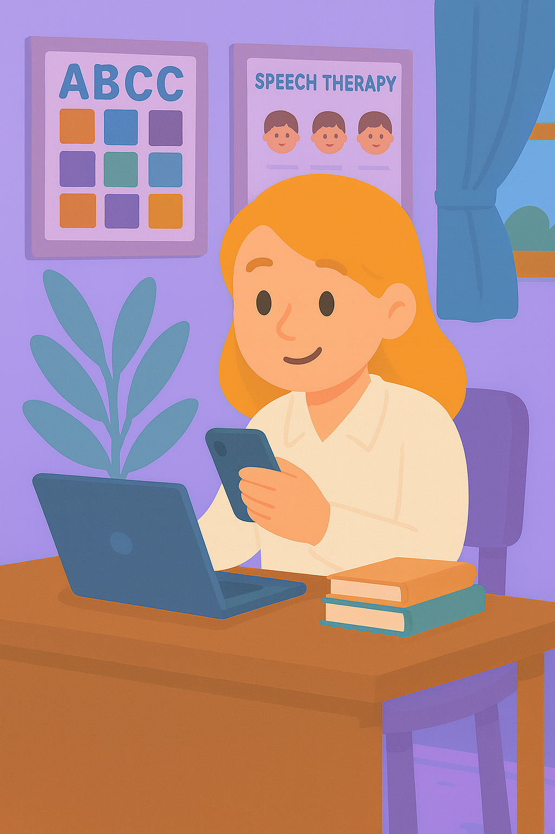
Genex – Dashboard
Helps:
Families understand their child’s situation better
Know what to ask their doctors
And providers to stay synched and give feeback.
Notes:
Voice over: Using the genex dashboard families understand their child’s situation better and know what to ask their doctors.
Genex Dashbord help providers to give feedback, modify the suggestions, and stay connected.

Slide 13
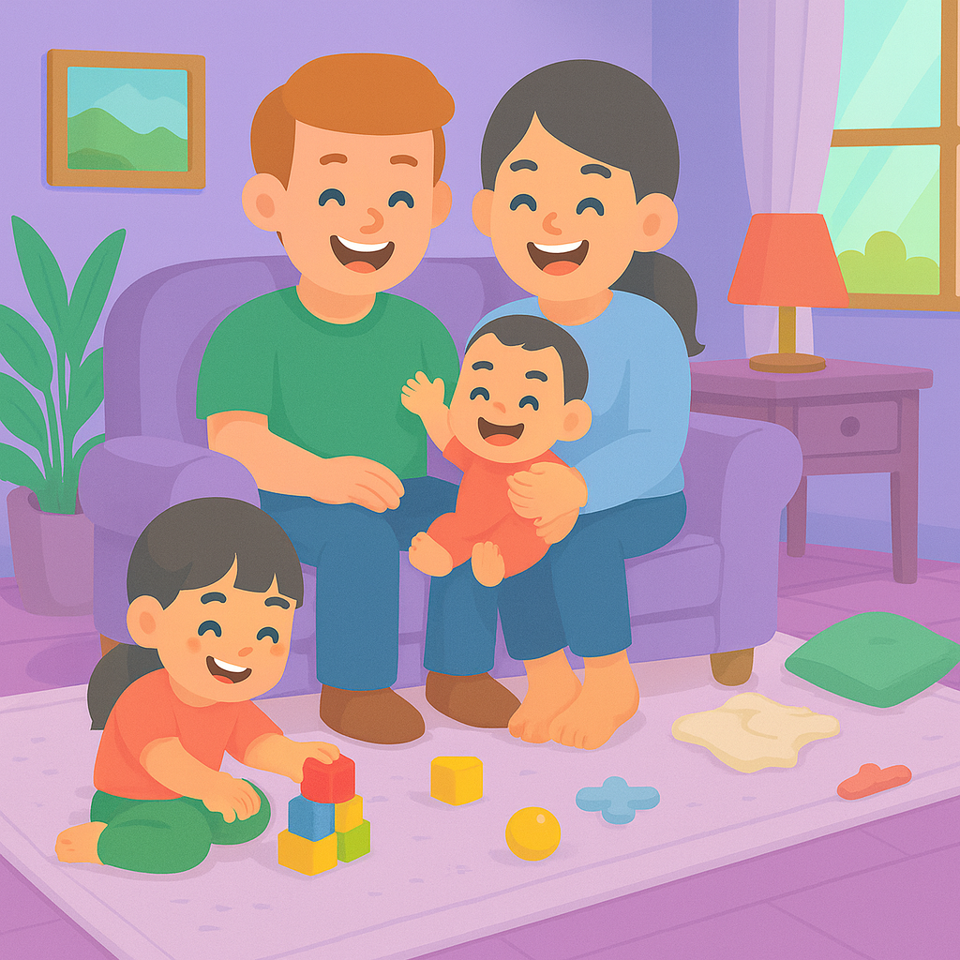
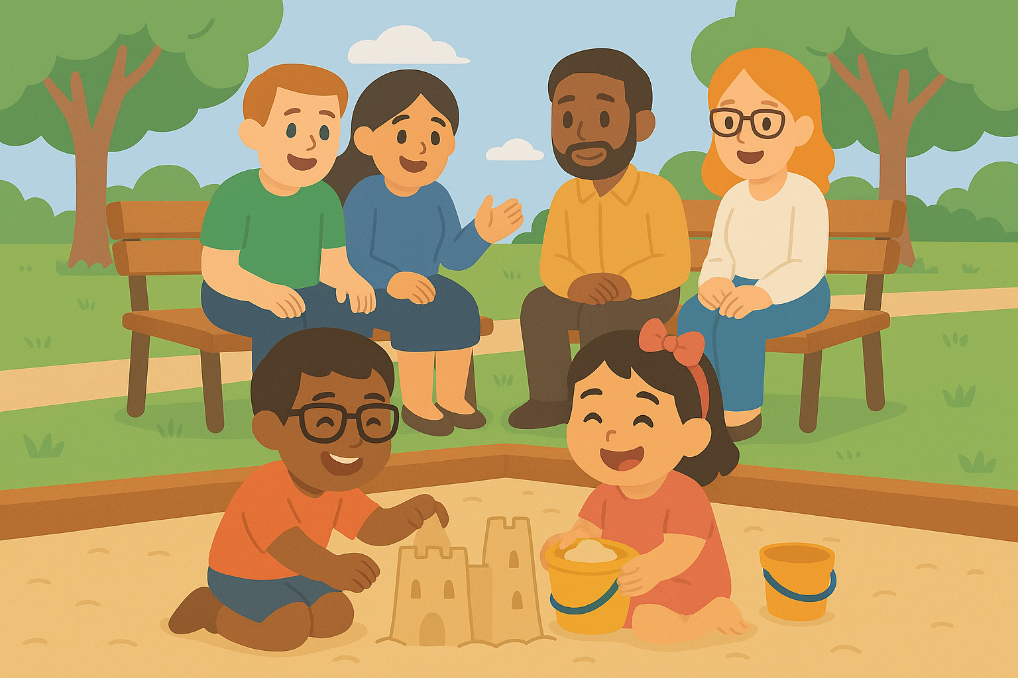
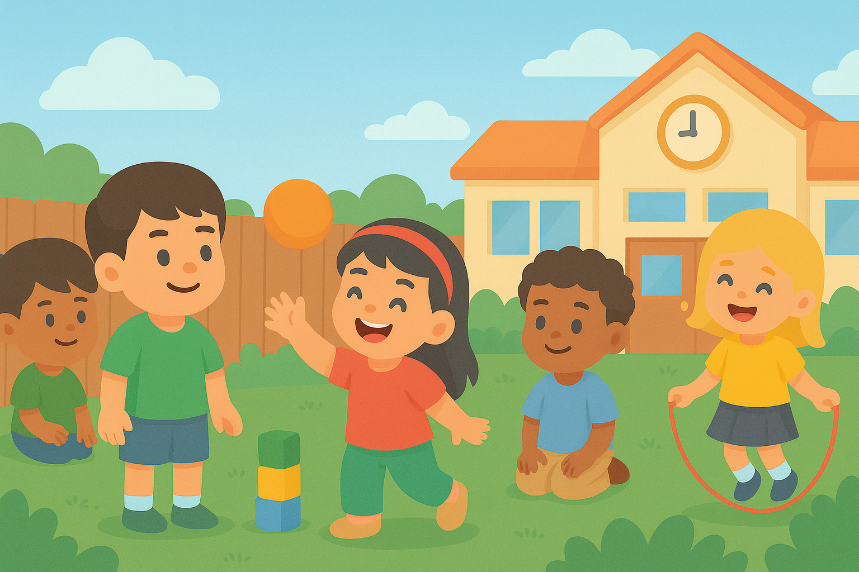
Together
Genex is where knowledge becomes care, and AI turns diagnosis into daily action.
Together we make care:
Simpler
Smarter
Supportive
Notes:
Plot: The video plays and voice go over the voice over at the same time.
Voice over: Genex is where knowledge becomes care, and AI turns diagnosis into daily action. Together, we make care simpler, smarter, and supportive.

Slide 14
GeneX
Genetics Made Practical
Notes:
Plot: The test come one word at a time, and then Genex logo appears.
Voice over: Together we make care simpler, smarter and supportive. Genex, Genetics made practical.

